Slide 1
Dynamics CRM Tablet Customization Considerations

Slide 2

Mitch Milam
mitch@xrmcoaches.com
@mitchmilam
blogs.infinite-x.net
xrmcoaches.com
crmaccelerators.net
rockmycrm.com

Slide 3
Agenda
Security considerations
Form functionality
JavaScript differences
Testing procedures
Q and A

Slide 4
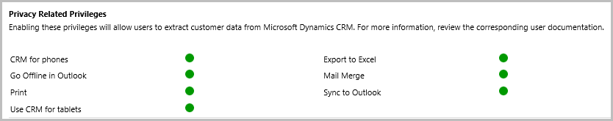
Security Considerations

Slide 5
Form Basics
CRM tablet client uses “New” forms
Only a select number of entities use the new forms

Slide 6
Entities with “New” Forms
Account
Appointment
Campaign
Campaign Activity
Campaign Response
Case
Competitor
Contact
Contract
Contract Line
Email
Fax
Invoice
Lead
Letter
Marketing List
Opportunity
Opportunity Product
Order
Phone Call
Price List Item
Product
Quick Campaign
Quote
Recurring Appointment
Sales Literature
Task
Team
User

Slide 7
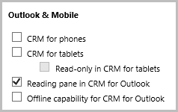
Entity Mobile Properties

Slide 8
Form Functionality
Flow layout switches automatically from vertical to horizontal scrolling
iFrames and Web Resources are removed

Slide 9
Form Functionality (cont.)
Single form (no form selector)
No ribbon, only command bar
Tabs are not collapsible

Slide 10
No Outlook–Related Methods
Xrm.Page.context.getCurrentTheme
Xrm.Page.uiViewPort Methods

Slide 11
No iFrame/Web Resource–Related Methods
Xrm.Page.getControl(arg).getInitialUrl()
Xrm.Page.getControl(arg).getObject()
Xrm.Page.getControl(arg).getSrc()
Xrm.Page.getControl(arg).setSrc(string)

Slide 12
Single Form. No Form Selector Methods
Xrm.Page.ui.formSelector.items
formSelector.getCurrentItem
formItem.getId()
formItem.getLabel()
formItem.navigate()

Slide 13
No Navigation–Related Methods
Xrm.Page.ui.navigation collection
.getId
.setFocus
.getLabel and .setLabel
.getVisible and .setVisible

Slide 14
Misc. Disabled Methods
Xrm.Page.ui.refreshRibbon
Xrm.Page.data.entity.getDataXml
Xrm.Utility.openWebResource
Xrm.Page.ui.getTab(x).setDisplayState

Slide 15
Always Check Your Environment
function isMobileClient() {
return Xrm.Page.context.client.getClient() == "Mobile";
}
if (!isMobileClient()) {
Xrm.Page.getControl("IFRAME_Statistics").setSrc("http://www.msn.com")
}
if (Xrm.Page.getControl("IFRAME_Statistics") != null) {
Xrm.Page.getControl("IFRAME_Statistics").setSrc("http://www.msn.com")
}

Slide 16
Composite Fields
Do not exist on CRM for Tablets
Perform an environment check before executing JavaScript against a composite field

Slide 17
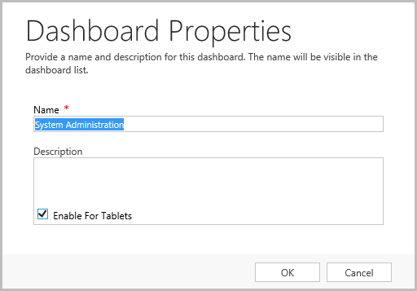
Dashboards

Slide 18
Dashboards (cont.)
Entities contained within dashboard must be tablet–enabled.

Slide 19
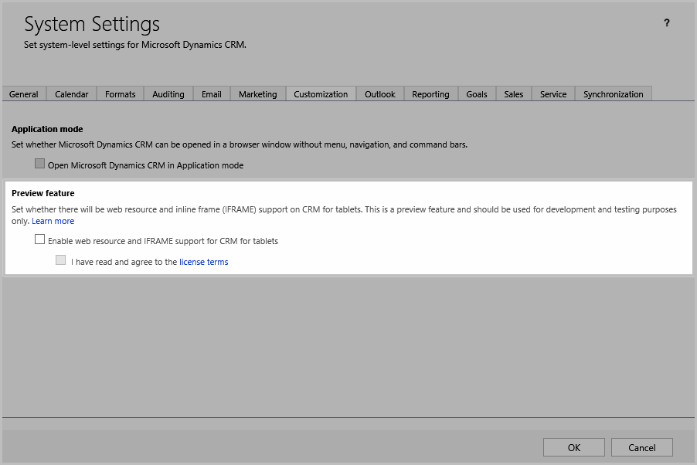
Preview Feature: iFrames and Web Resources

Slide 20
Testing – General
Always test on a real device
Install Dynamics CRM Client for Windows 8+ from the Windows Store

Slide 21
Testing – JavaScript
Test all JavaScript functionality
OnLoad
OnSave
OnChange

Slide 22
Testing – Form Layout
Does the layout of the form flow correctly on CRM for Tablets?
What compromises need to be made?
Do you need separate forms?

Slide 23
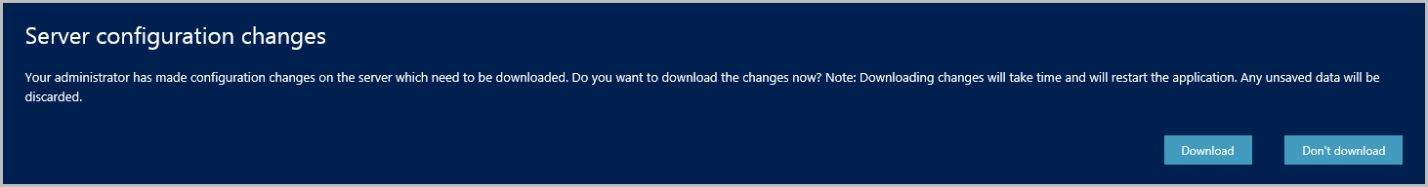
Training
Train users to download metadata changes

Slide 24
Discussions

Slide 25
Thank You

